Slide 1

U.S. Hospital Analysis performance exploratory Data analysis (EDA)
Group 1: Nenad Barac, Connor Mulshine, Hyojun Kim, Utsav Thota

Slide 2
Project AGENDA
Business Proposal
Dataset Overview
Goal
Business Use Case
Data Modeling
Relational
Dimensional
Key Assumptions
3. Business Intelligence Reporting
Tableau Dashboarding
4. Summary
Summary of Analysis
Dataset Limitations
Further Analysis
Conclusion

Slide 3
Business proposal | dataset Overview
Dataset comes from studies conducted of more than 4,000 hospitals across the U.S., taking place over 6-month timeframes
Metrics reveal 30-day readmission rates, as well as mortality rates, of patients treated for:
Acute myocardial infarction
Heart failure
Stroke
Chronic obstructive pulmonary disease
Pneumonia
Coronary artery bypass graft
Hip/knee replacement
https://www.kaggle.com/datasets/thedevastator/us-healthcare-readmissions-and-mortality?resource=download

Slide 4
Business proposal | Goal
Develop a BI tool that summarizes hospital performance across the US, utilizing KPIs to compare patient outcomes across:
Hospitals
Regions
Hospital Networks
Size of hospital (determined by volume of patients treated per day)
Provide summary of findings

Slide 5
Business proposal | BUSINESS USE CASE
Primary benefit of helping hospitals identify areas for improvement
Hospitals can see compare performance to others in their:
County
State
Hospital Network
Patients, insurance providers, administrators, and other healthcare providers also stand to benefit from this analysis
Potential motivator for a deeper dive analysis on a specific hospital/hospital network

Slide 6

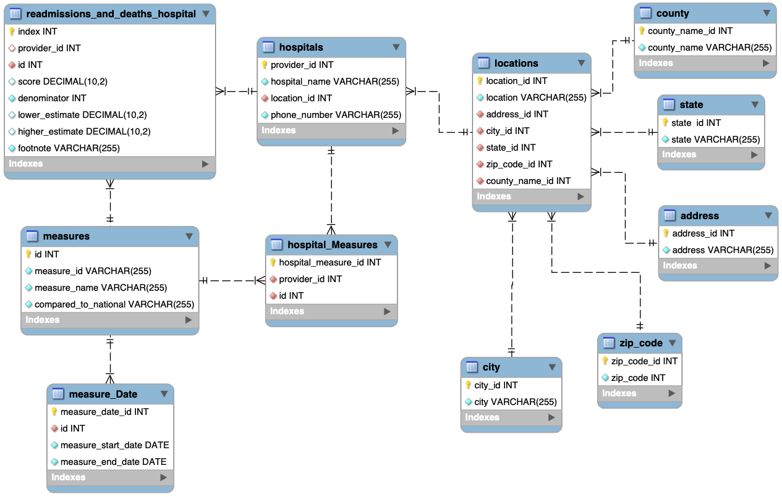
Data modeling | 3NF Relational
11 Relational Tables:
readmissions_and_deaths_hospital
measures
measure_Date
hospitals
hospital_Measures
locations
city
zip_code
county
state
address

Slide 7
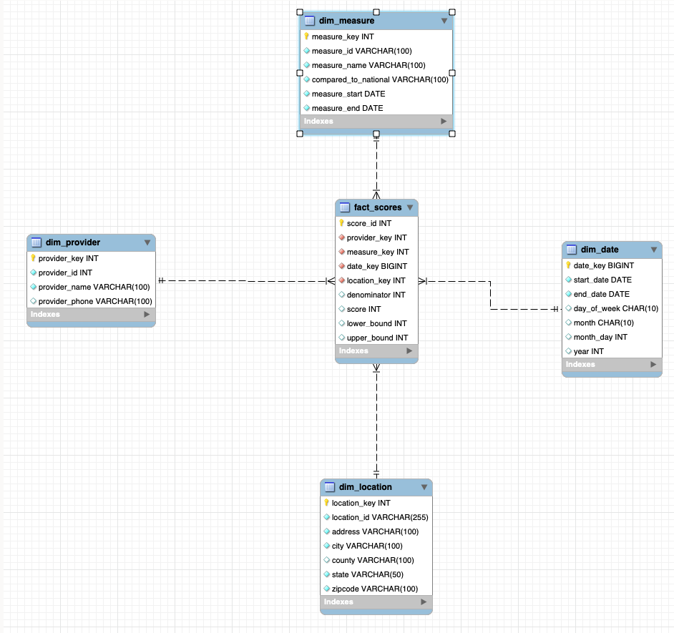
Data Modeling | Dimensional
1 Fact Table
fact_scores
4 Dimensional Tables
dim_location
dim_date
dim_Measure
dim_provider

Slide 8

Data Modeling | Key Assumptions
Relevant dimensions and measures
Useful hospital performance insights
Careful selection criteria applied
Primarily for reporting and analysis
Non-transactional data usage
Decision-making support tool
Accuracy and completeness of data
Assumptions based on accurate data

Slide 9





Business Intelligence | Tools

Slide 10
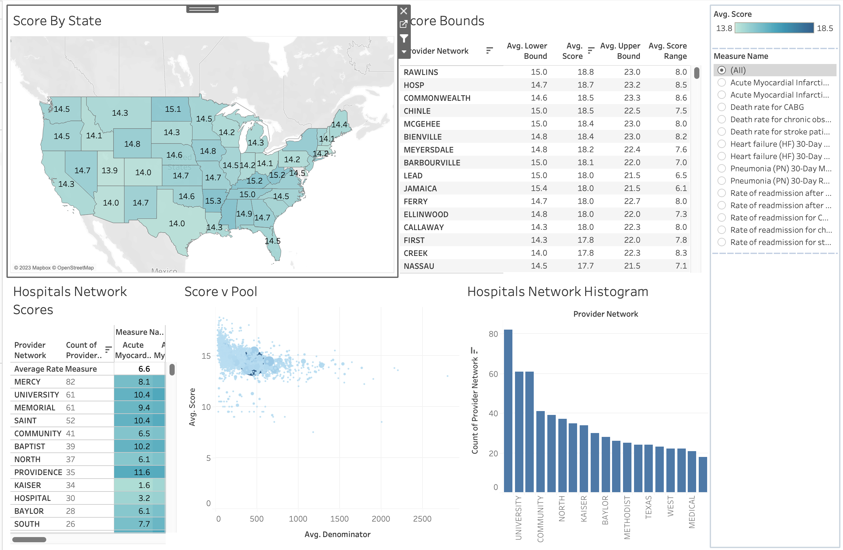

Business Intelligence | Tableau Dashboard
DEMO

Slide 11
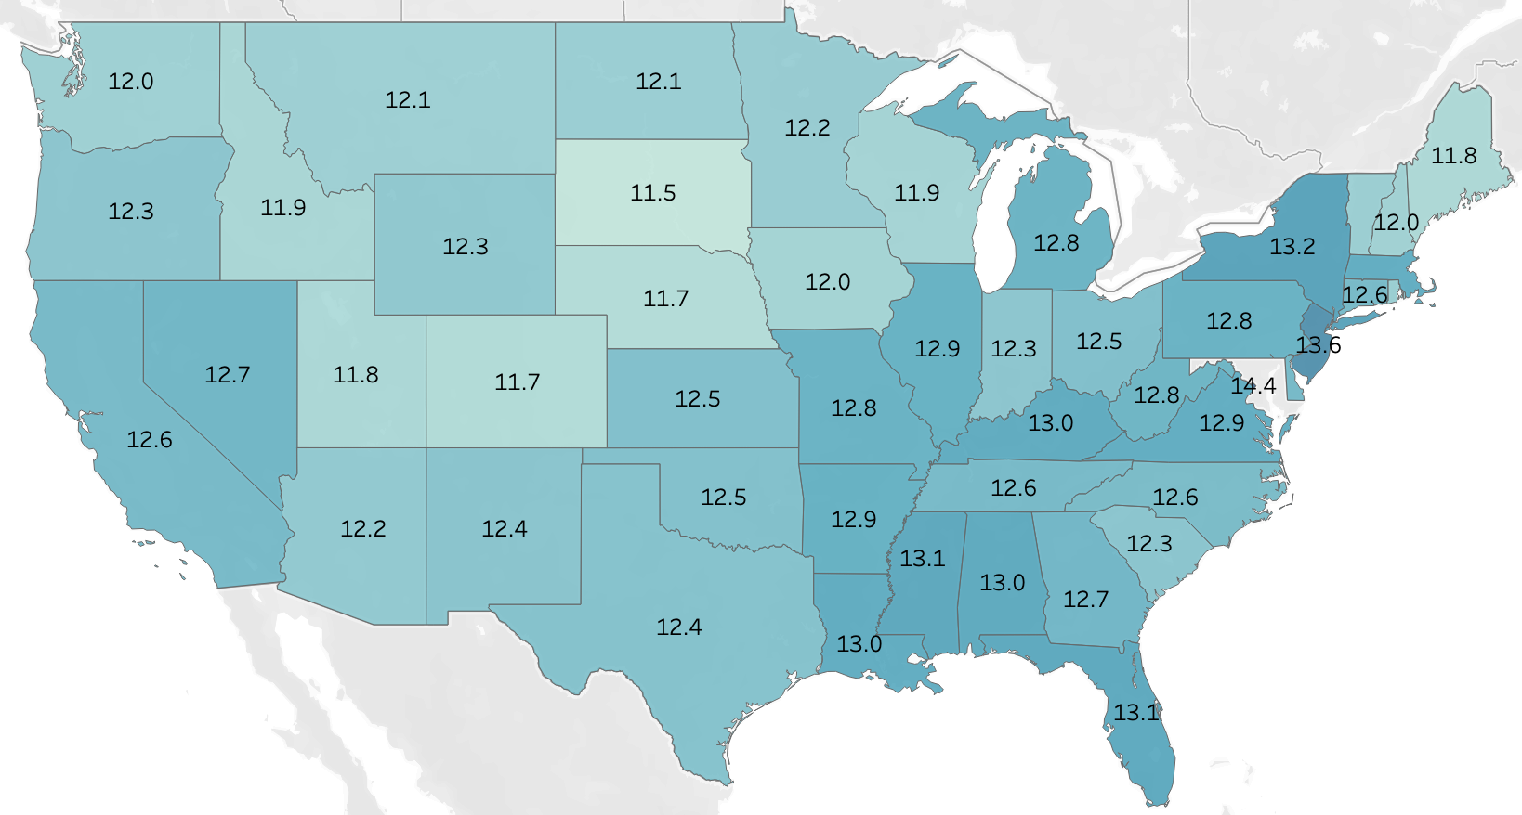

Summary of Analysis
Clear geographical difference in patient outcomes
Readmission rate for stroke patients
Heart failure readmission rate

Slide 12
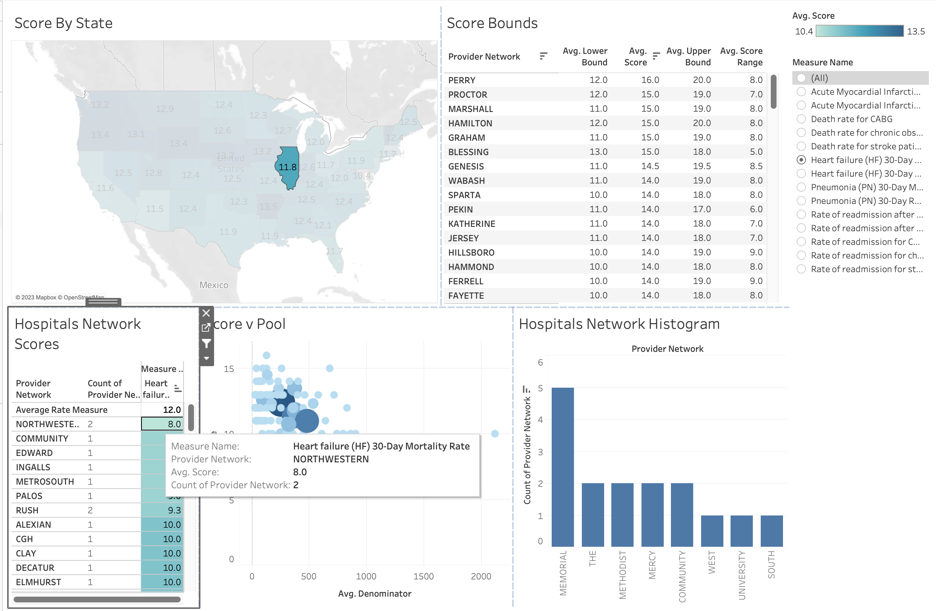
Summary of Analysis
Min: 8
→ Northwestern
Max: 17
→ Advocate
Avg: 12

Slide 13
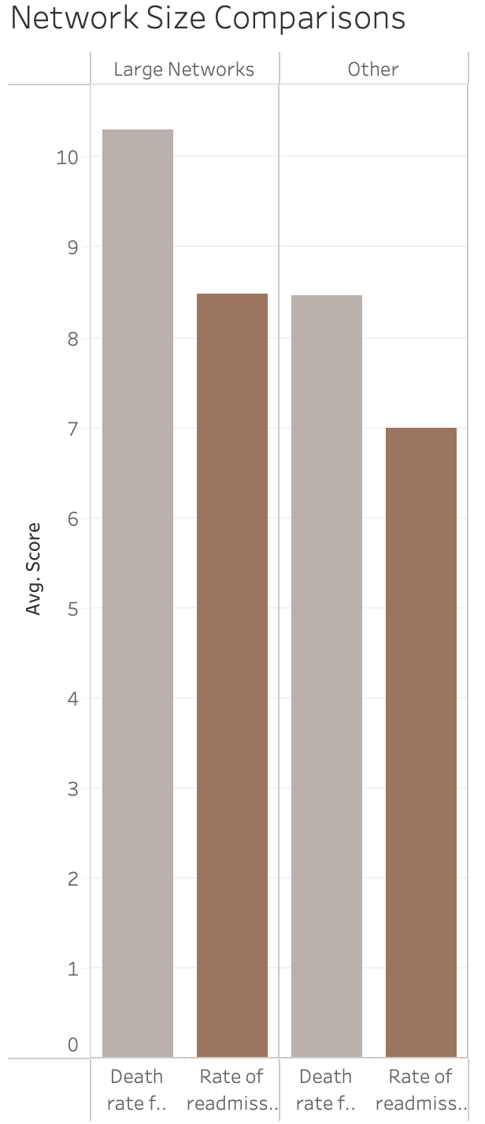
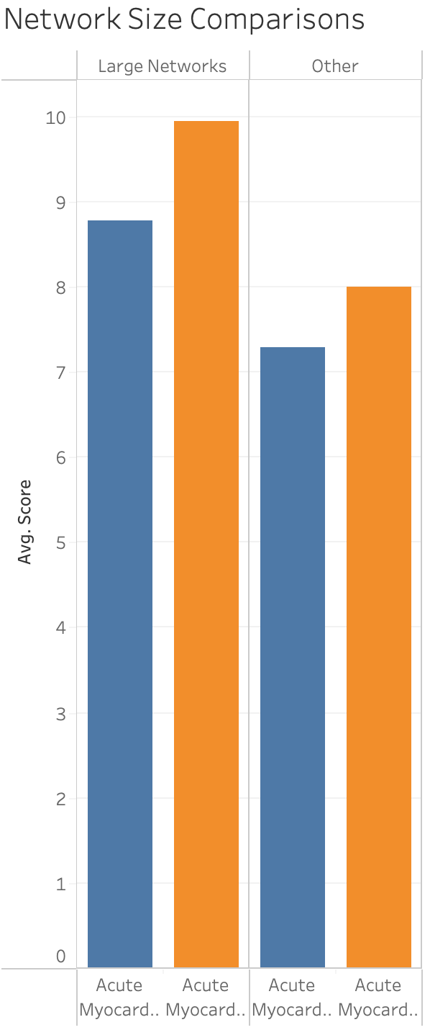
Summary of Analysis
Large networks of hospitals fare comparatively worse on most measures
Correlation requires further investigation
Stroke mortality & readmission rates (left)
Acute Myocardial Infection (AMI) mortality & readmission rates (right)

Slide 14
Dataset limitations
Unreported scores for several hospitals
Limited timeframe
Hospital networks not included

Slide 15
further analysis
Additional data on hospital resources & operations (staffing, patient experience, etc.)
Impact of Medicare/Medicaid reimbursement rates
Join to demographic data

Slide 16
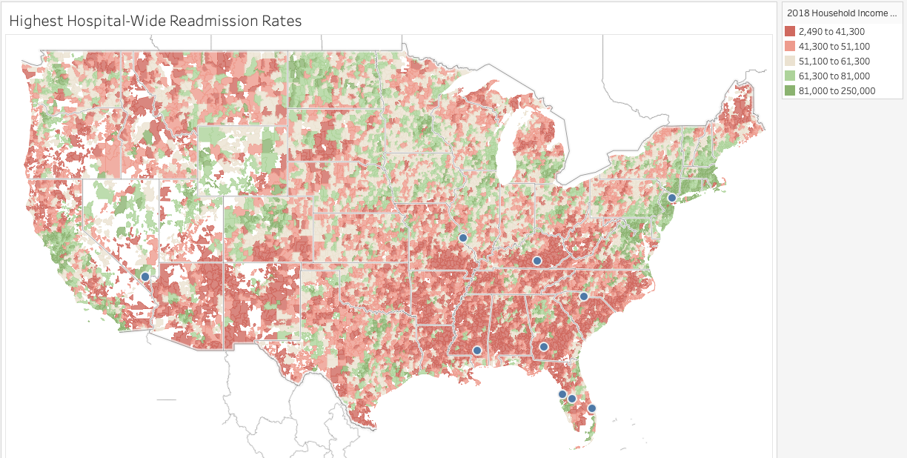
FURTHER ANALYSIS

Slide 17
Questions?

